Slide 1
SECURE DATA HIDING IN IMAGES USING STEGANOGRAPHY
CAPSTONE PROJECT
Presented By: Akash R
Student Name : Akash R
College Name & Department : Adhiyamaan College of Engineering(Autonomous), Department of Information Technology

Slide 2
OUTLINE
Problem Statement
Technology used
Wow factor
End users
Result
Conclusion
Git-hub Link
Future scope

Slide 3
Problem Statement
Traditional encryption techniques are frequently vulnerable to interception and decryption by unwanted parties, despite the growing need for secure data transfer.
Traditional data protection methods could cause suspicion, which leaves them open to attacks.
To safely integrate sensitive information in digital media without compromising its perceptual quality, a discreet, reliable, and effective method is required.
To enable safe and undetected transmission of sensitive data, the solution will concentrate on improving embedding efficiency, resilience to attacks, and preserving the carrier image's visual integrity.
The goal of this project is to create a **Secure Data Hiding in Images Using Steganography** system that will guarantee that private information is hidden inside pictures while remaining highly imperceptible and resistant to steganalysis.

Slide 4
Technology used
Libraries Used in the Program:
OpenCV (cv2) – Used for reading, modifying, and saving images.
OS (Used to execute system commands (e.g., opening the encrypted image).
String (Provides character manipulation utilities (though not used explicitly).
Platform Compatibility:
The program is designed for Windows (due to os.system("start encryptedImage.jpg") for opening the image).
It can run on Linux/macOS with minor
Requires Python 3.x with OpenCV (cv2) installed (pip install opencv-python).

Slide 5
Wow factors
UNIQUE FACTORS:
Custom Encryption Logic
Passkey-Protected Decryption
Real-Time Image Encryption & Decryption

Slide 6
End users
End Users of the Project :
Cybersecurity Professionals
Corporate & Business Organizations
Privacy-Conscious Individuals

Slide 7
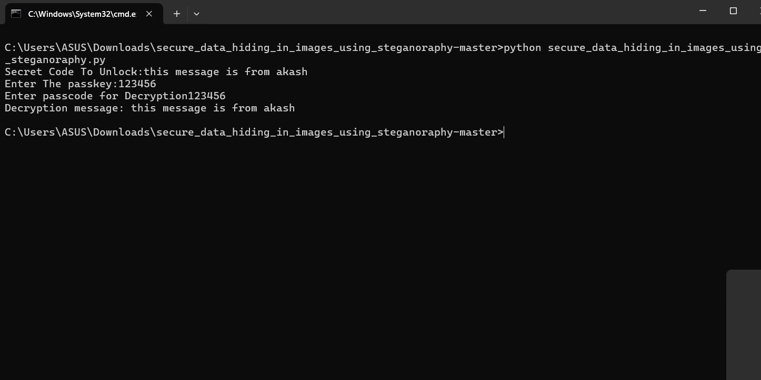


Results

Slide 8
Conclusion
The Safe Information Concealed in Pictures The difficulty of secret data transfer is well addressed by the Steganography project, which embeds private data into digital images while preserving their aesthetic integrity. While traditional encryption techniques can draw attention and be intercepted, this technology guarantees that private communications are invisible to unauthorized parties. The solution improves security and stops unwanted access by utilizing passkey-protected decryption and direct pixel manipulation. Minimal picture distortion is guaranteed by the use of a lightweight yet powerfuls teganographic approach, which makes it an ideal solution for secure communication in a variety of fields, such as cybersecurity, law enforcement, and corporate data protection.

Slide 9
GitHub Link
The GitHub link :https://github.com/Akash11092/-secure_data_hiding_in_images_using_steganoraphy

Slide 10
Future scope(optional)
My Future Scope in Cyber Security is to learn about to protect myself from cyber threats and protect my identity

Slide 11
THANK YOU

